Slide 1
SWITCHING THEORY AND LOGIC DESIGN
UNIT-5
BY
S.SAGAR KRISHNA,
ASSISTANT PROFESSOR,
GAYATRI VIDYA PARISHAD COLLEG OF ENGINEERIN(A)

Slide 2
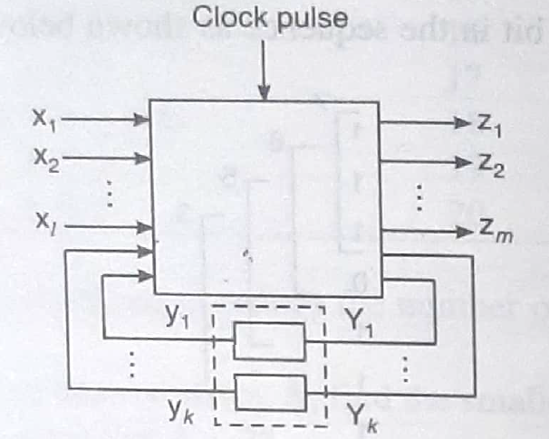
FINITE STATE MACHINES

Slide 3
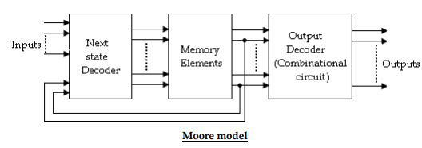
FINITE STATE MACHINES
The synchronous or clocked sequential networks are represented by two models.
Moore model: The output depends only on the present state of the Flip-Flops.
Mealy model: The output depends on both the present state of the Flip-Flops and on the inputs.
Moore model: In the Moore model, the outputs are a function of the present state of the Flip-Flops only. The output depends only on present state of Flip-Flops, it appears only after the clock pulse is applied, i.e., it varies in synchronism with the clock input.

Slide 4
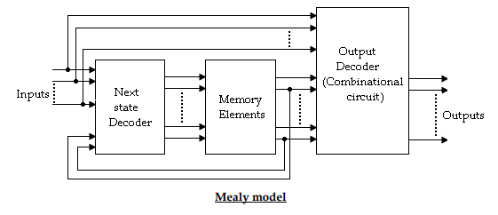
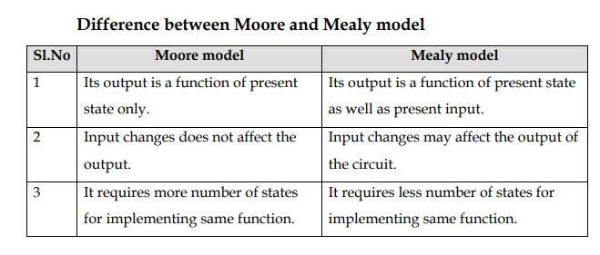
FINITE STATE MACHINES
Mealy model: In the Mealy model, the outputs are functions of both the present state of the Flip-Flops and inputs

Slide 5
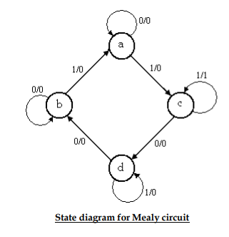
STATE DIAGRAM
It is a pictorial representation of a behavior of a sequential circuit.
In the state diagram, a state is represented by a circle and the transition between states is indicated by directed lines connecting the circles. A directed line connecting a circle with circle with itself indicates that next state is same as present state. The binary number inside each circle identifies the state represented by the circle. The directed lines are labeled with two binary numbers separated by a symbol ‘/’. The input value that causes the state transition is labeled first and the output value during the present state is labeled after the symbol ‘/’.
In case of Moore circuit, the directed lines are labeled with only one binary number representing the state of the input that causes the state transition. The output state is indicated within the circle, below the present state because output state depends only on present state and not on the input.

Slide 6
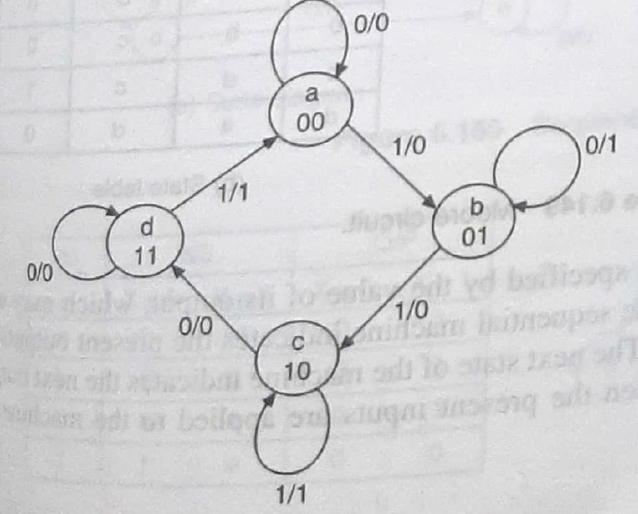
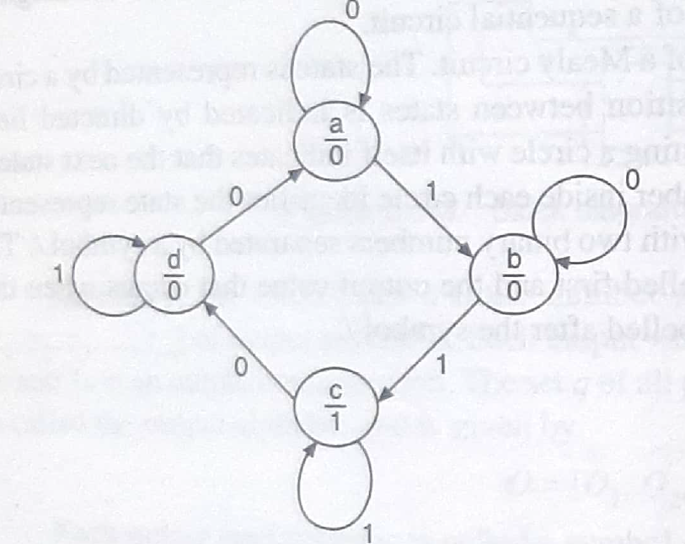
STATE DIAGRAM

Slide 7
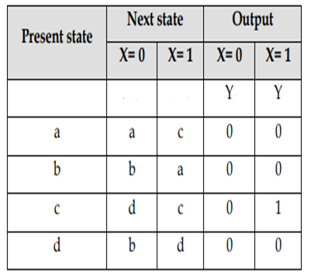
STATE TABLE
It represents relationship between input, output and Flip-Flop states. It consists of three sections labeled present state, next state and output. o The present state designates the state of Flip-Flops before the occurrence of a clock pulse, and the output section gives the values of the output variables during the present state. o Both the next state and output sections have two columns representing two possible input conditions: X= 0 and X=1.

Slide 8
STATE TABLE
It represents relationship between input, output and Flip-Flop states. It consists of three sections labeled present state, next state and output. o The present state designates the state of Flip-Flops before the occurrence of a clock pulse, and the output section gives the values of the output variables during the present state. o Both the next state and output sections have two columns representing two possible input conditions: X= 0 and X=1.

Slide 9
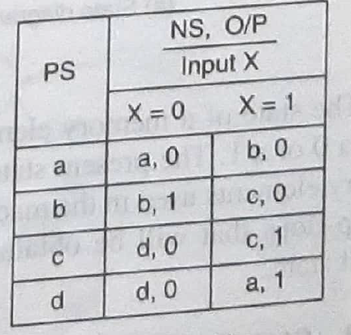
STATE TABLE

Slide 10
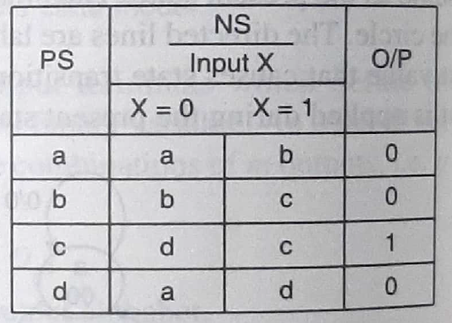
STATE TABLE

Slide 11
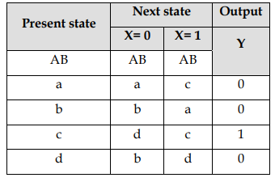
STATE TABLE
In case of Moore circuit, the output section has only one column since output does not depend on input. and X=1.
Successor: A’s 1 successor is c and A’s 0’s successor is A(used in partition technique)
State Equation: It is an algebraic expression that specifies the condition for a Flip-Flop state transition. The Flip-Flops may be of any type and the logic diagram may or may not include combinational circuit gates.
State Reduction: If some states have same Next State and output then this state becomes a redundant state.This state can be removed. This process is known as State Reduction
State Assignment: In this process each state is assigned a binary value

Slide 12
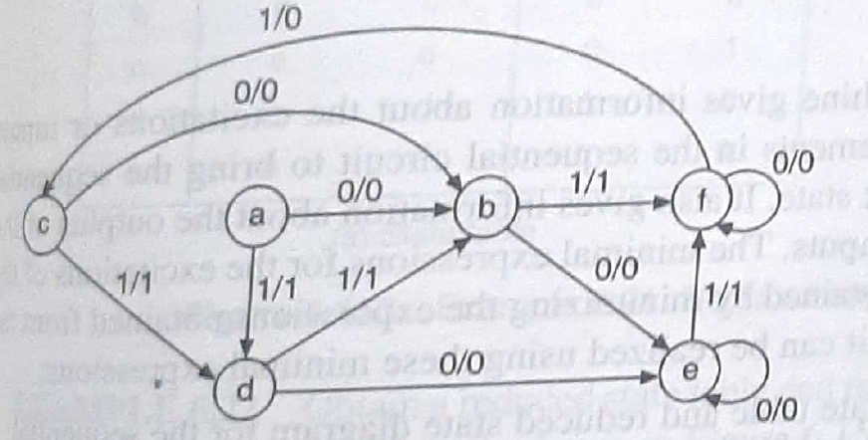
STATE REDUCTION

Slide 13
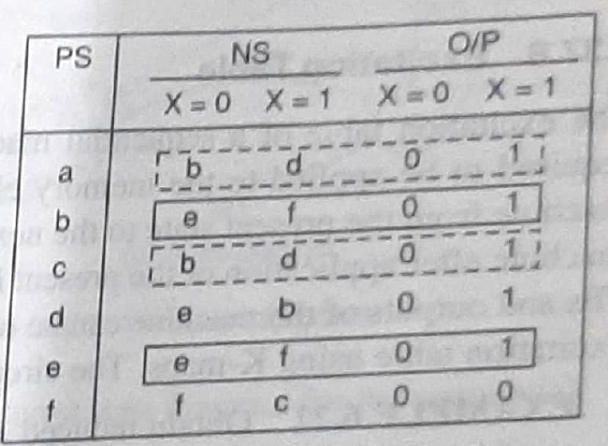
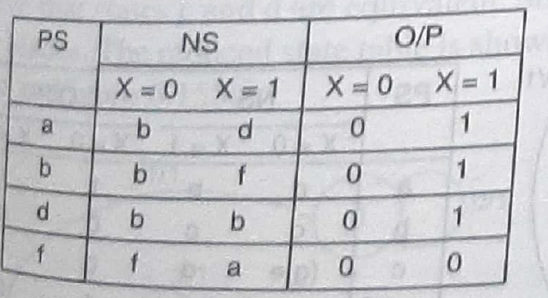
STATE REDUCTION

Slide 14
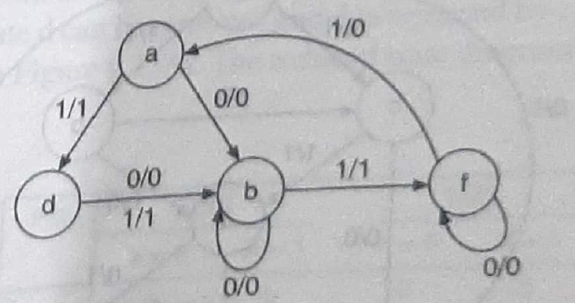
STATE REDUCTION

Slide 15
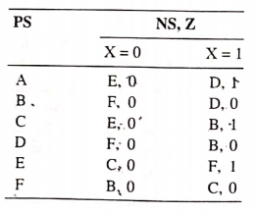

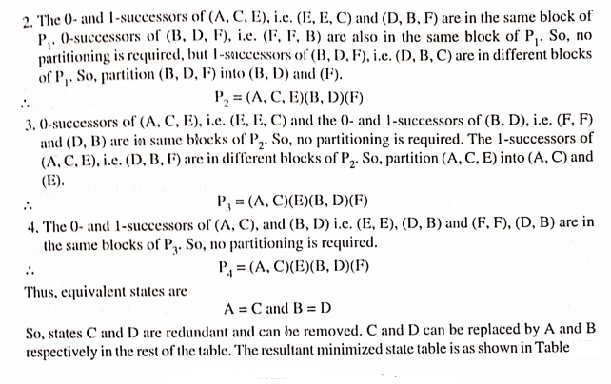
PARTITION TECHNIQUE
This also helps in reducing no of States
Example:

Slide 16
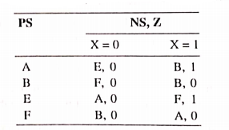
PARTITION TECHNIQUE
Reduced State Table:

Slide 17
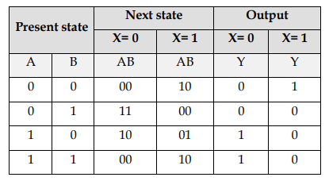
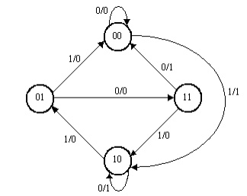
DESIGN A CIRCUIT FOR A GIVEN STATE DIAGRAM USING D FLIP-FLOP:
State Table

Slide 18
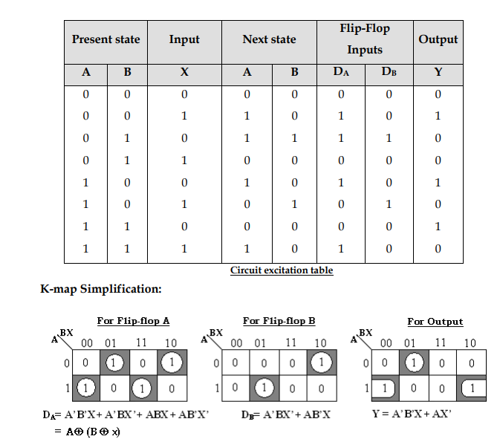
DESIGN A CIRCUIT FOR A GIVEN STATE DIAGRAM USING D FLIP-FLOP:

Slide 19
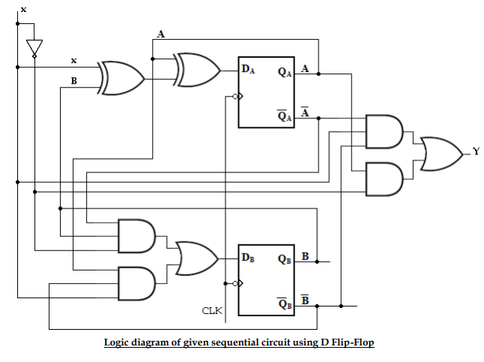
DESIGN A CIRCUIT FOR A GIVEN STATE DIAGRAM USING D FLIP-FLOP:

Slide 20
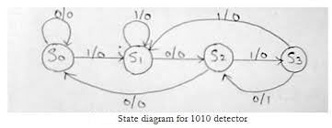
DESIGN A SEQUENCE DETECTOR TO DETECT SEQUENCE 1010 FOR MEALY TYPE
First draw the state diagram to detect the Sequence 1010(consider overlapping).
When the Sequence is completed the output will be 1.
After drawing State diagram the design procedure is same as explained in slides 9 to 11.
First State table, Excitation table, Boolean Expressions, Logic diagram
Here
S₀=00
S₁=01
S₂=10
S₃=11
After that repeat the same procedure mentioned in slides 17 to 19

Slide 21
DESIGN A SEQUENCE DETECTOR TO DETECT SEQUENCE 1010 FOR MEALY TYPE
When S₀=0 we have to wait in the same state with output =0 and if S₀=1 we move to S₁ with output =0
When S₁=0 we move to S₁ with output =0 and if S₀=1 have to wait in the same state with output =0
When S₂=0 we move to S₀ as the sequence is wasted with output =0 if S₂=1 we move to S₃ with output =0
When S₃=0 we move to S₂ as the sequence is completed as it is overlapping and output =1 as sequence is completed and if S₃=1 we move to S₁ as it is overlapping and output =0
(If you have doubts look into this video design procedure is present here https://www.youtube.com/watch?v=k8xxGSkJUhY for non overlapping and overlapping sequence)
After State Assignment, repeat the same procedure mentioned in slides 17 to 19

Slide 22
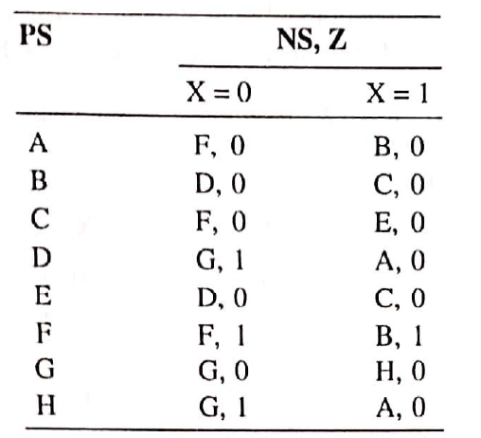
ASSIGNMENT -5 QUESTIONS:
Design a Sequence Detector to detect the sequence 1011 for Mealy type using D-flip-flop.
Design a Binary Serial Adder for Moore Type.
Reduce the following State Table using Partition Technique.

Slide 23
THANK YOU

